Slide 1

CEIR Operations - Training Manual

Slide 2

Agenda
Operations - Definition and Overview
Interface
Features
Block/Unblock Device
Alert Management
Running Alert Management
IP Log Management
SLA Management
System Flow
Impact

Slide 3
Operation – Overview
Once the project is launched, there would be few operational task that CEIR operational team has to do.
Operation user are those set of users who will be doing these tasks.

Slide 4
Operations Team – System Interface

Slide 5
Operation Registration
Operations can be configured from the CEIR Admin portal
CEIR Admin will create the Operation users and share the details offline to CC agent users

Slide 6

Alerts - Feature Overview
There are 2 features:
Alert List: This contain the list of all alerts configured in the system
Running Alerts: This contain the list of alerts raised in the system, when any unexpected event occurs
Operation User
Alerts
Alerts
Operation User login into the portal
Operation user view the alert information.
System shows the alert information
CEIR System

Slide 7
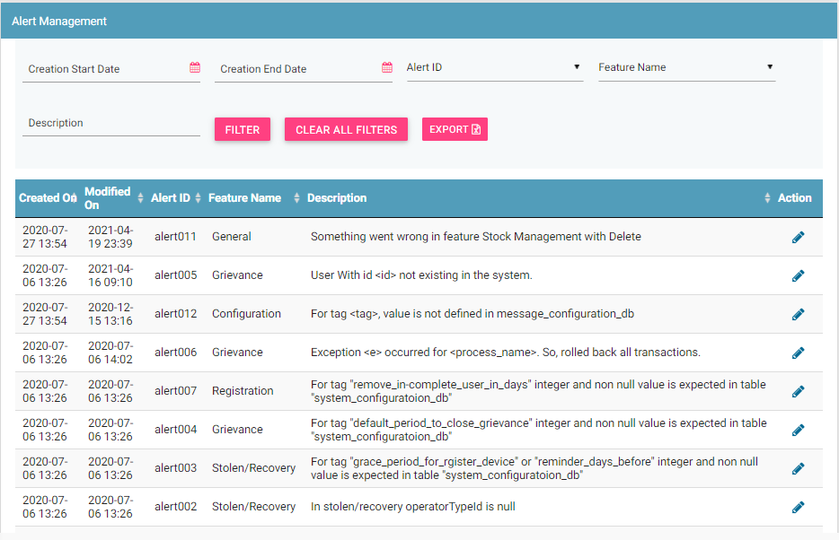
Alerts List

Slide 8
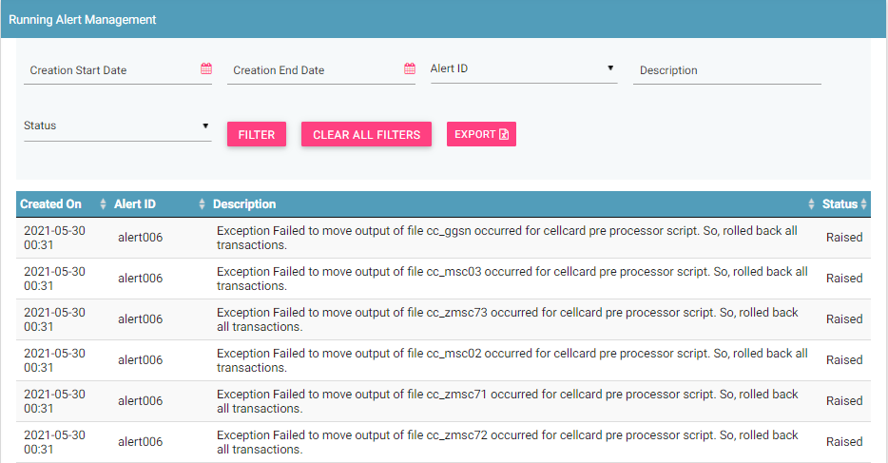
Running Alerts

Slide 9
IP Log Management
When any user / stakeholder access the system, the first activity being done is Login to the portal.
IP log management captures the first access to the system
In case when the access is without login, like end user feature at DMC Home Portal, the same is also logged in the portal

Slide 10
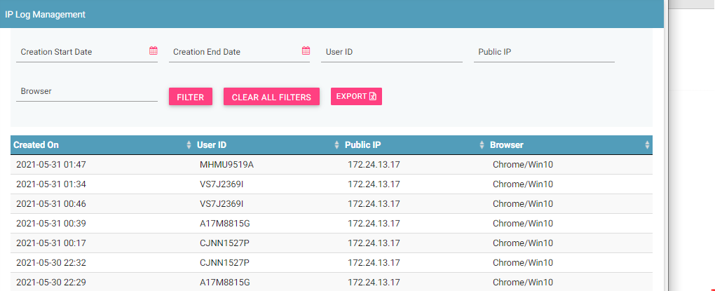
IP Log Management - GUI

Slide 11
SLA Management
CEIR Admin is assigned certain set of task to be done. These task are primarily pertaining to the approval to all request raised to CEIR Admin. Examples:
Consignment Management
Stock Management
Block Device
Unblock Device
Stolen Device
Recovery Device

Slide 12
Impact
This user and feature is required to performing operations as raised by end user and stakeholder

Slide 13
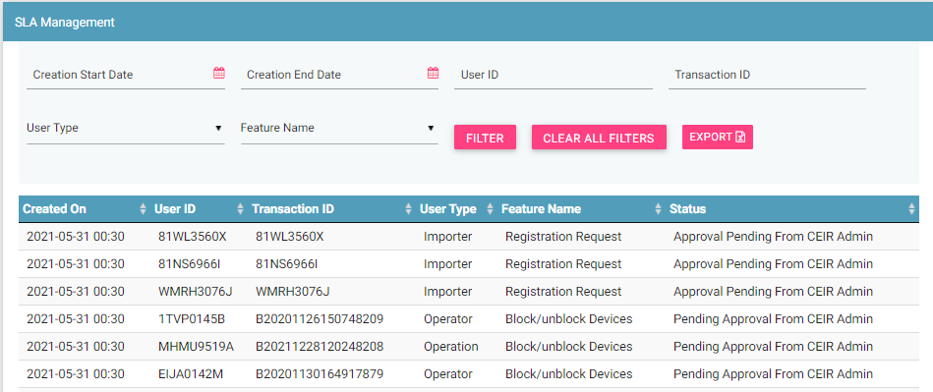
SLA Management

Slide 14
Block / Unblock Devices – Operations
Operations user may block or unblock one or more devices due to various reasons.
One of the reasons could be subscription contract violation between user and operator. Since user has violated the subscription contract, operator may raise a request to block devices.
Once the subscription contract is restored with user, operations user will revoke the block request by sending unblocking request
Both single and bulk request mode are supported

Slide 15
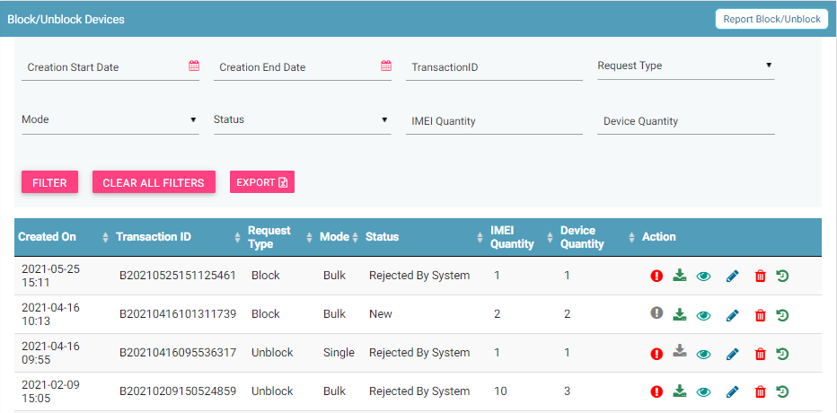
Block / Unblock Devices – Operator
Filters
Report Block/ Unblock
Export
Action like Error, Download,View, Edit & Delete
View All requests

Slide 16
Queries

Slide 17
Thank You

